Slide 1

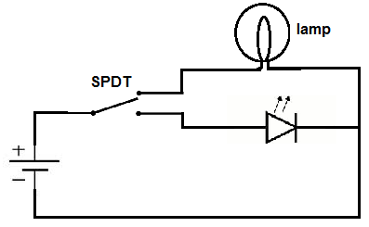
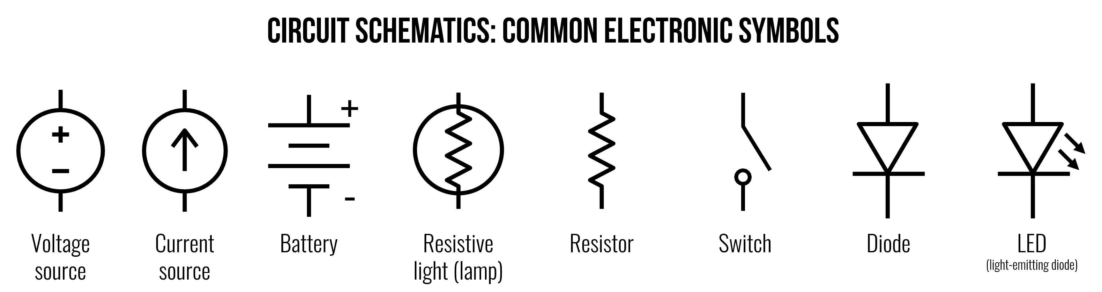
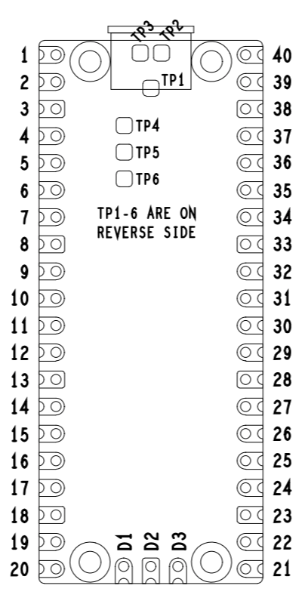
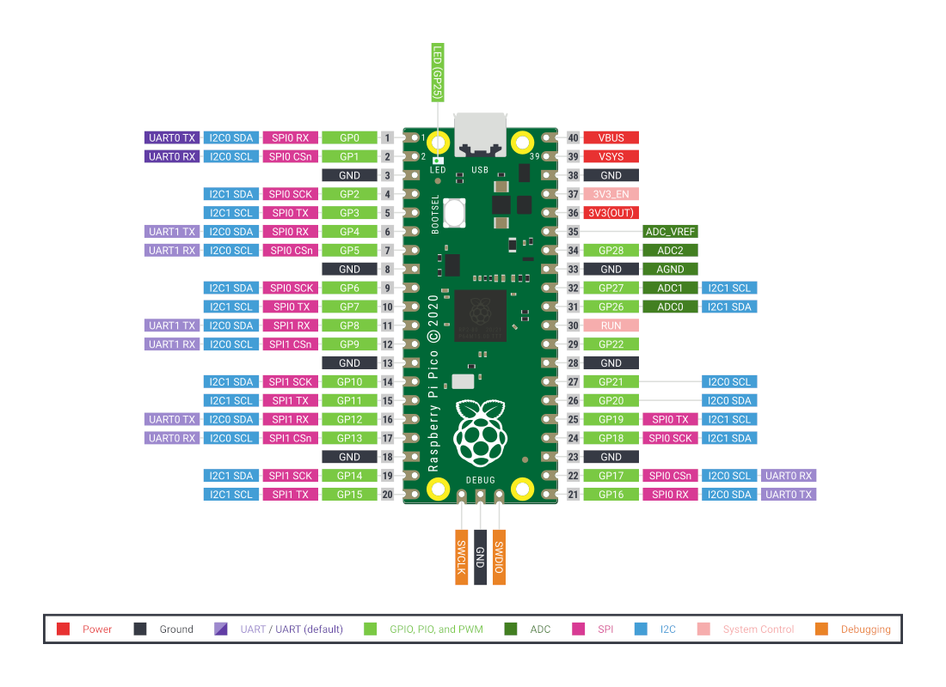
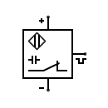
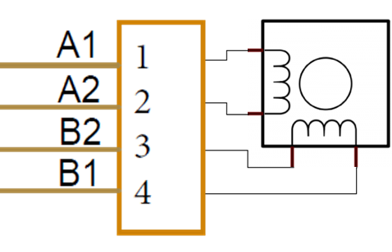
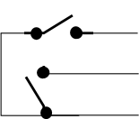

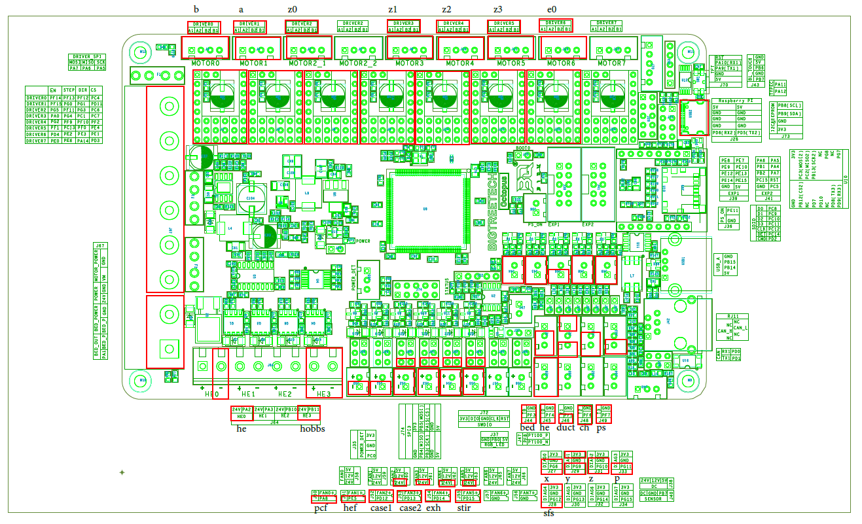


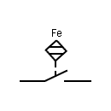
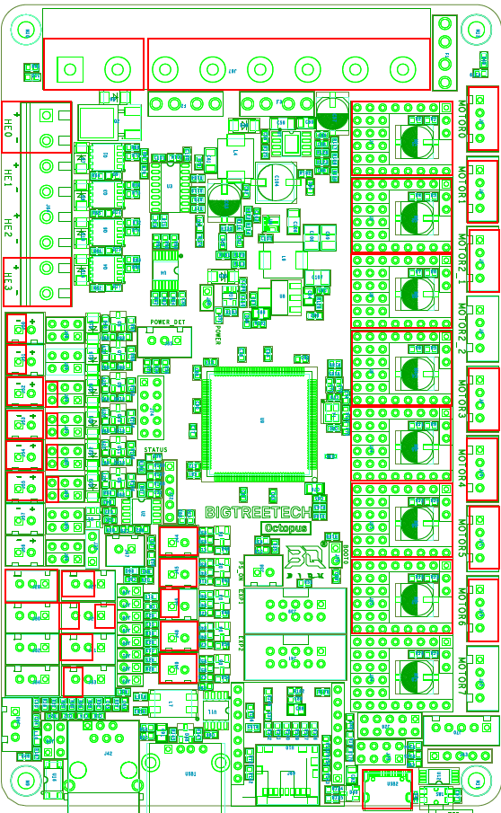
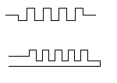
Inductive
Current Probe
Power
Meter
Temp Probe
110VAC
Power
Outlet
Sonoff S31 Outlet Tasmota-ized
Power
Inlet
I1
I2
H
N
T1
T2
Emergency
Stop Switch
Hot Neu Gnd
Hot Neu Gnd
AC
Power
Cord
Hot Neu Gnd
Fuse
Switch
Switched 5VDC Orange
Unswitched 5VDC
Red
NC
C
NO
In Out
C
NO
}
}
}
WiFi Logic Relay
Pwr Relay Module
DC Gnd
Black
ERCF 8x1 Neopixel (on ‘Dashboard’)
Lamp +V
Gnd
+V
Sig
Gnd
TH 6
}
}
}
}
}
TH 3
AC Hot
Black
AC Neu
White
AC Gnd
Green
DC Gnd
Black
24VDC
Red
UnSw 5V 8A PS (Lights/ctl)
X
X
TH 4
Hot Neu AC Gnd
LED +5V DC Gnd
5VDC Powered 4 port USB 3.0 Hub (See Notes 3 & 4)
Front Skirt
Power Switch
TH 5
4.7K .1%
NC
C
NO
x
Sw 5V 4A PS (Pi RP2040)
+V In Gnd In
NC
C
NO
Hot Neu AC Gnd
MCU +5V DC Gnd
Host 1 2 3 4
Acer ChromeBox (Klipper Host)
Red
Green
Blue
MCU2 rPi Pico
MCU1 Octopus
Nozzle Cam
#1
DIN
Rail
#2
DIN
Rail
Nozzle Cam
MCU3 ERCF (Xiao)
Lamp Gnd
24V 8A PS
4ea DOTSTAR LED Strips – 1 circuit 228 LEDs
Hot Neu AC Gnd
+24V +24V +24V DC Gnd DC Gnd
DC Gnd
+5VDC
Clock
Data ←
Gnd
+5VDC
Clock
Data ←
Gnd
+5VDC
Clock
Data ←
Gnd
+5VDC
Clock
Data ←
Gnd
This is milspec 24awg 4cond shielded ETFE wire MIL-W-27500-24SB4T23-3 Mfg by Raychem (TE)
Back Left Front Right
Line Load
In +
In -
H2O Flow
SSR
24-12 DC Buck Converter for Water Cooling
5v0
Sig
Gnd
H2O Temp
Bed
Heater Pad
Temp Bed
Disconnect
Bed Pwr Disconnect
Neu
1 1
24-5 DC Buck Converter for ERCF
A A
Hot
TempSens
2 2
B B
Therm Fuse 1
Therm Fuse 2
Gear
ERCF EasyBrd
Bed
Extrusion
Gnd Knife
Disconnect
Chassis Gnd
Cart
ERCF Filament Sensor
F M
3v3
Sig
Gnd
Stand-alone Flow Indicator & Temp Gauge
+ - P T
+ - P T
~MHz Accelerometerized Tool Head PCB
Temp Probe
Radiator Fan
Water Pump
Not Used
XES
Sig
Gnd
HE Temp
Sig
AGnd
SPI Signal Level
Shifters
24v->3v3 Power Supply
+24V CSEL
SCLK
MOSI
MISO
GND
1
2
3
4
5
6
7
8
9
10
11
12
13
14
15
16
17
18
1
2
3
4
5
6
7
8
9
10
11
12
13
14
15
16
17
18
N/C
Pico 2
Pico 4
Pico 5
Accelerometer Sensor
Circuitry on back of PCB
Pico 1
B
A
Z0
Z1
Z2
Z3
Duct Temp
Sig
AGnd
ABL
ABL(VSG) or Klicky(SG)
+24V
Sig
Gnd
Hour
Meter
HE0
+V Gnd
+24V
Sig
PCF
+24V
Sig
E0
HEF Removed (Water Cooled Hotend now…)
HEF
+24V
Sig
Aft Chassis Fan
8x1 Neopixel (on ‘Dashboard’)
Fore Chassis Fan
Chamber Exhaust Fan
5VDC PSU Fan
Chamber Filter/Stir Fans
X/Y End Stop PCB
24VDC PSU Fan
Gnd
X Sig
Y Sig
3v3
Z End Stop PCB
(Mechanical)
Chamber Thermistor
LCD Display
Z Sig
Gnd
PSU Thermistor
(Mechanical)
Notes: 1) Klipper Host is an Acer Chromebox CXI2 running Ubuntu 20.04.3 LTS
2) Modified EZY BRD so 5VDC powers ERCF MCU (see note 4) 3) USB 3.0 Hub connects Host to MCU1 (Octopus v1.1), MCU2 (RP2040 on rPi Pico), MCU3 (Xiao on ERCF Easy BRD), and Nozzle Cam 4) Hub has power switches for each USB client device – MCU 1-3 port’s power switch to remain in the off position so they are powered down when the switched DC power supplies power down

